Slide 1
Learning Programming Languages
Lecturer: Ngo Huy Bien
Software Engineering Department
Faculty of Information Technology
VNUHCM - University of Science
Ho Chi Minh City, Vietnam
nhbien@fit.hcmus.edu.vn

Slide 2

Objectives
To learn a programming language by yourself.
To read code of an existing system.

Slide 3

Contents
Motivation
Programming language syntax
The foundation of a programming language
Programming language generations
Programming paradigms
Code reading
Demo: React and Functional Programming

Slide 4

References
David S. Frankel (2003). Model Driven Architecture - Applying MDA to Enterprise Computing. Wiley Publishing.
Dave Thomas and Brian M. Barry (2003). Model Driven Development – The Case for Domain Oriented Programming. OOPSLA.
Peter Van Roy (2009). Programming Paradigms for Dummies - What Every Programmer Should Know.
Robert Pickering (2009). Beginning F#. Apress.
Diomidis Spinellis et al. (2003). Code Reading: The Open Source Perspective. Addison-Wesley Professional.

Slide 5
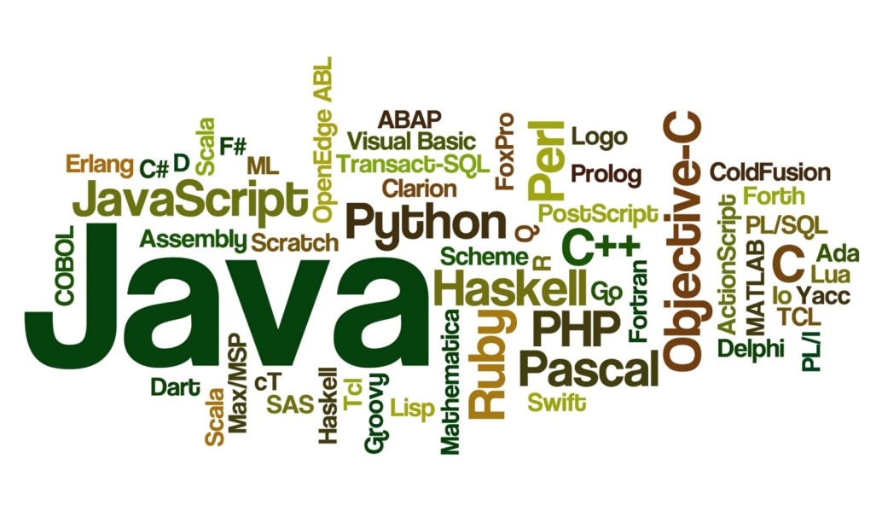
Why Learn a New Programming Language?
1
Make money
Get a job (job requirement).
Startup (solving a problem)
Language selection
Faster development
Code reading
Code writing
Hobby
Problem/need.
Open yourself up to new ideas and approaches.
2

Slide 6

Warming Up
Hello World!
Development environment setup
Source code (files) structure
Build/Run/Debug
Compiled vs. interpreted programs
The problems it addresses.
Real world problems
Small exercises
Concepts

Slide 7
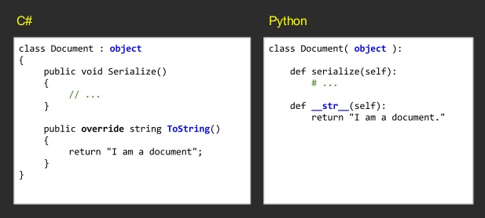
Syntax
Syntax is easy to learn if you have a foundation.

Slide 8

What is the Foundation?
Primitive types: int, float, double, string, date/time, null.
Basic constructs: variables & assignments, pointers, declarations, functions, macro.
Control flow: if/else, while, switch, for, break, continue, recursion, exception, parallelism, signal, jump.
User-defined types: struct, class, type.
Data structures: array, list, linked list, queue, stack, set, hashtable/map/dictionaries, tree, hierarchical structure.
OOP: abstraction, encapsulation, class-based inheritance, prototype-based inheritance, polymorphism.
Functional programming: first-class and higher-order functions, no side effects, recursion.
Modularity: files, packages, namespaces, libraries, modules.
Concurrency: processes, threads, locks, channels, timers, callbacks, events, promises, event loop.
Type system: static type, dynamic type.
Error handling: try/catch.
Metaprogramming: reflection, template programming, DSL.

Slide 9
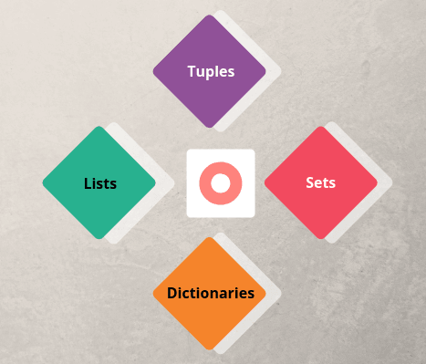
Example (Python)
Types
Expressions and Variables
String Operations
Tuples and List
Dictionaries
Sets
Conditions and Branching
Loops
Functions
Objects and Classes (OOP)
Modules, Libraries and Packages

Slide 10
What's Next?
Revisit programming language syntax (Java, C#, PHP, Python, Ruby, JavaScript, Kotlin, Swift, Go)

Slide 11
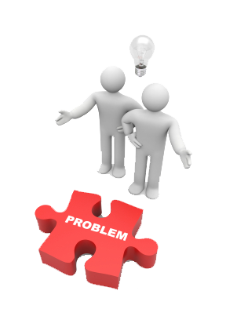
What's Next?
Platform (i.e. project structure, namespaces/packages, class hierarchy) (e.g. JEE, .NET)
Libraries (i.e. functions) (e.g. PHP, Numpy)
But wait! We need a problem first! → Example: code reading task.

Slide 12


Slide 13
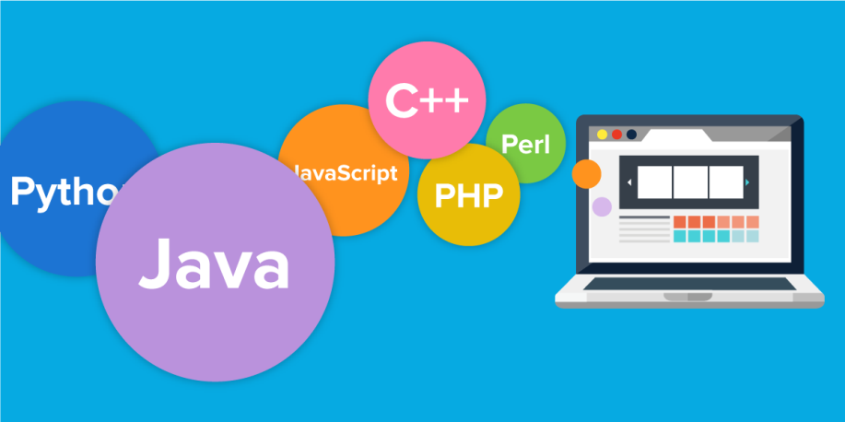
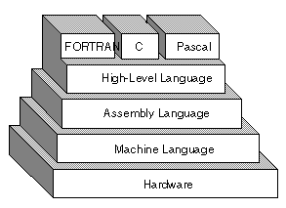
Programming Languages
Why so many programming languages?
Which problems did they solve?

Slide 14
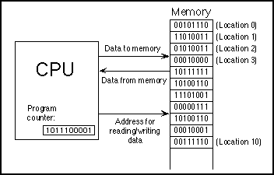
Native CPU Instructions [1]
Native CPU instructions are sets of 1s and 0s that tell machine to do something.
Available memory and processor
speed optimization.
Labor-intensive 1s and 0s coding.
Coupled with high hardware costs.
Sharply limited the number of tasks amenable to computerization.
The first generation languages, or 1GL, are low-level languages that are machine language.

Slide 15
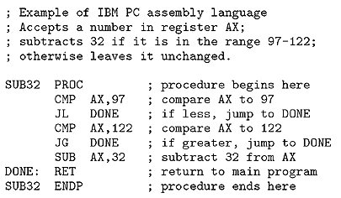
Assembly Languages
Assembly language is a development language consisting of simple mnemonics that represent the native instructions
MOV AX, DX
Less time-consuming.
Less prone to error.
Less sensitive to incremental changes of processors.
Low productivity: A simple routine could require hundreds of instructions.
The second-generation languages, or 2GLs, are also low-level assembly languages.

Slide 16
Third Generation Languages (3GLs)
Language compilers translate the higher-level instructions into native processor instructions (machine code).
PRINT “Hello World” (FORTRAN COBOL, Pascal, C)
Fewer instructions.
The ability to think entirely in terms of the programming models defined by the 3GLs.
The ability to retarget 3GL programs to different processors.
The third-generation languages, or 3GL, are high-level languages, such as C, C++, Java, JavaScript, and Visual Basic.

Slide 17
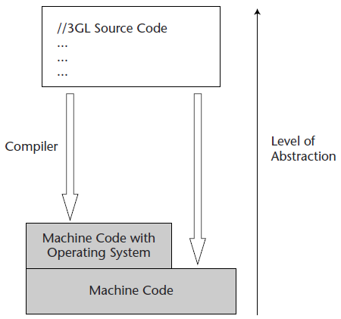
3GLs with Operating Systems
Whereas 3GLs raised the level of abstraction of the programming environment, operating systems raised the level of abstraction of the computing platform.
If a 3GL compiler has to produce detailed machine code for routine functions such as disk and display manipulation, its job is harder than if it can simply generate machine code that invokes operating system disk and display services.

Slide 18
Object-Oriented 3GLs
Structured 3GLs evolved into object-oriented 3GLs, including Smalltalk and C++. These new languages make it easier to reuse parts of programs in different contexts.
Some object-oriented languages introduce an interpreter called a virtual machine that executes intermediate code generated by the language compiler. Smalltalk, Java, and C# are the prime examples of such languages.
The intermediate code is processor- and operating-system-independent.
Thus, implementing the virtual machine over different processors and operating systems makes it possible to port even the compiled form of applications to different computing environments.
// Java language statements
public boolean handleEvent (Event evt) {
switch (evt.id) {
case Event.ACTION_EVENT: {
if ("Try me".equald(evt.arg)) {

Slide 19
4th Generation Languages (4GLs) [2]
4GLs refer to nonprocedural high-level languages designed to simplify CRUD (Create, Read, Update, Delete) programming and report writing.
Successful 4GLs such as SQL, Focus, RPG-II, Adabas, Powerhouse, Mapper and Synon increased programmer productivity by providing language constructs that modeled the application domain.
They did so without burdening the user with the complexity of extraneous computer science concepts.
4GLs may not always be well suited to building complex applications, but a major advantage of 4GLs is that simple things can be implemented simply (an advantage is not shared by JEE or .Net).
Fourth generation languages are commonly used in database programming and scripts examples include Perl, PHP, Python, Ruby, and SQL.
// A 4GL language statement
EXTRACT ALL CUSTOMERS WHERE "PREVIOUS PURCHASES" TOTAL MORE THAN $1000

Slide 20
Domain Specific Languages
A DSL is a machine-processable language whose terms are derived from a specific domain model, which is used for the definition of components or software architectures supporting that domain.
A DSL is tailored for a particular application domain, and captures precisely the semantics of that application domain – no more, no less.
A DSL allows one to develop software for a particular application domain quickly and effectively, yielding programs that are easy to understand, reason about, and maintain.

Slide 21
DSL Example
# pull official base image
FROM node:12.18.3-alpine3.12
# set working directory
WORKDIR /mtreleases
# install app dependencies
COPY package.json ./
COPY package-lock.json ./
RUN npm install
# copy all local files to image
COPY . ./
#Expose port and start application
EXPOSE 3000
CMD ["npm", "start"]

Slide 22
5th Generation Languages (5GLs)
A fifth generation (programming) language (5GL) is a grouping of programming languages build on the premise that a problem can be solved, and an application built to solve it, by providing constraints to the program (constraint-based programming), rather than specifying algorithmically how the problem is to be solved (imperative programming).
When the programmer dictates how the solution should look, by specifying conditions and constraints in a logical manner, the computer is then free to search for a suitable solution.
Most of the applicable problems solved by this approach can currently be found in the domain of artificial intelligence.

Slide 24
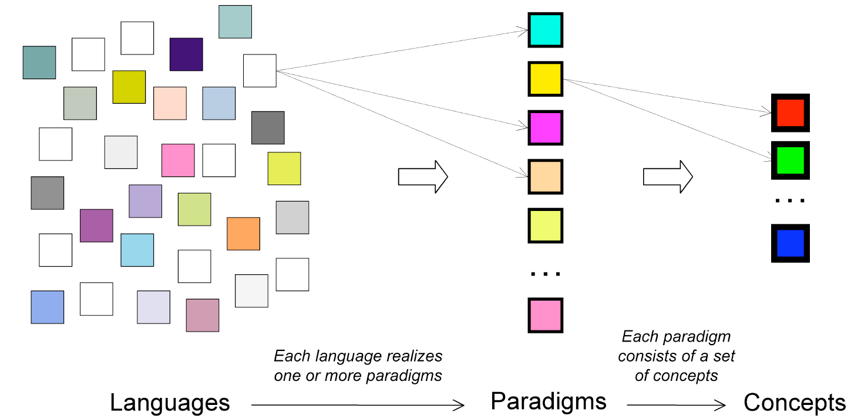
What are Programming Paradigms? [3]
A programming paradigm is an approach to programming a computer based on a mathematical theory or a coherent set of principles.

Slide 25

Why Care About Programming Paradigms?
To learn a new programming language faster.
To use a programming language more wisely.

Slide 26
Procedural & Declarative Programming
Procedural programming.
HOW a computation should be performed.
C, C++, Java, C#.
Declarative programming.
WHAT properties a computation should satisfy.
General declarative programming (HTML, SQL)
Functional programming: LISP, Miranda, Haskell, Closure, F#.
Logic programming: Prolog.

Slide 27
Procedural Programming
Main building blocks of procedural programming languages are:
constants, variables and built-in operators
expressions formed from these
assignment of values of expressions to variables
sequencing of statements
repetition (while, for, repeat)
support for parameterized sub-programs (procedures, functions)
recursion
rich set of data types
pointers

Slide 28
Functional Programming [4]
Pure functional programming views all programs as collections of functions that accept arguments and return values.
Unlike imperative and object-oriented programming, it allows no side effects and uses recursion instead of loops for iteration.
The functions in a functional program are very much like mathematical functions because they do not change the state of the program.
In the simplest terms, once a value is assigned to an identifier, it never changes, functions do not alter parameter values, and the results that functions return are completely new values.

Slide 29
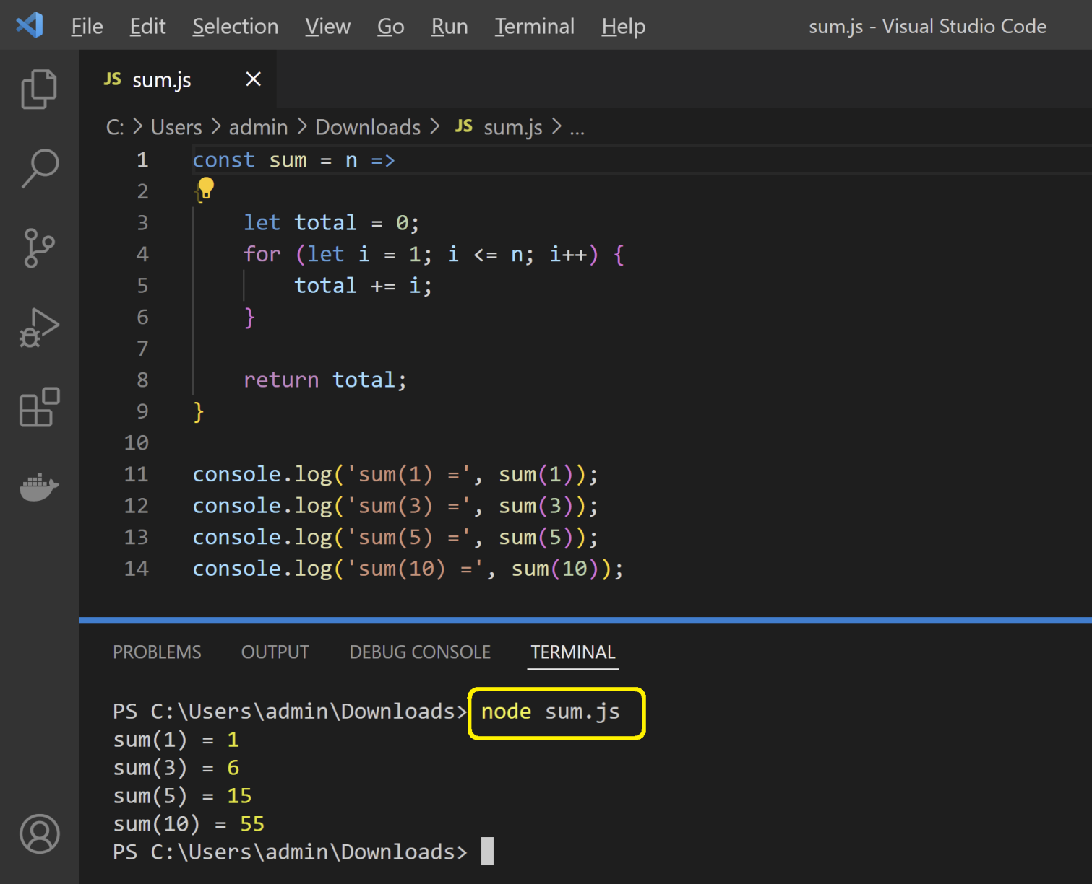
Run JavaScript in VS Code

Slide 30
Recursive Version
function sum(n)
{
if (0 == n) return 0;
return n + sum(n-1);
}
console.log('sum(1) =', sum(1));
console.log('sum(3) =', sum(3));
console.log('sum(5) =', sum(5));
console.log('sum(10) =', sum(10));

Slide 31
Functional Version
function sum(n)
{
// Array.from(arrayLike, mapFn)
// arrayLike: An array-like or iterable object to convert to an array.
// array-like objects: objects with a length property and indexed elements.
// iterable objects: objects such as Map and Set.
// mapFn: Optional Map function to call on every element of the array.
// mapFn: (v: any, k: number) => number
const numbers = Array.from({length: n}, (_, i) => i + 1);
// const value = array.reduce(callback[, initialValue]);
// The callback is an obligatory argument that is a function performing the reduce operation,
// and the second optional argument is the initial value.
return numbers.reduce((previousValue, currentValue) => {
return previousValue + currentValue;
}, 0);
}
console.log('sum(1) =', sum(1));
console.log('sum(3) =', sum(3));
console.log('sum(5) =', sum(5));
console.log('sum(10) =', sum(10));

Slide 32
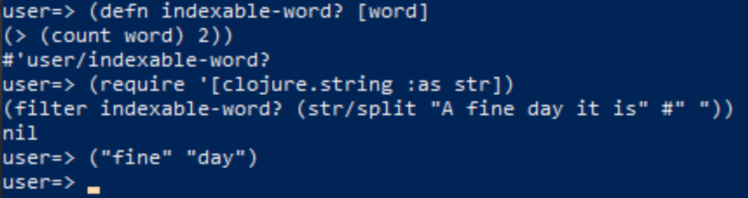
Clojure Example
(defn indexable-word? [word]
(> (count word) 2))
(require '[clojure.string :as str])
(filter indexable-word? (str/split "A fine day it is" #" "))
The call to split breaks the sentence into words, and then filter calls indexable-word? once for each word, returning those for which indexable-word? returns true.

Slide 33
F# Example
Arguments of a function should be indented further than the call to the function.
open System
open System.IO
let writeToFile (date:DateTime) filename text =
let path = sprintf "%s-%s.txt" (date.ToString "yyMMdd") filename
File.WriteAllText(path, text)
[<EntryPoint>]
let main argv =
writeToFile DateTime.UtcNow.Date
"first-file"
"The quick brown fox jumped over the lazy dog"
let writeToTodayHelloWorld =
writeToFile DateTime.UtcNow.Date
"hello-world"
writeToTodayHelloWorld "The quick brown fox jumped over the lazy dog"
0 // return an integer exit code

Slide 34
Logic Programming (I) [3]
Main building blocks of logic programming are:
constants, variables and built-in operators
predicates, taking constants and variables as arguments
rules for defining new predicates
hence, support for sub-programs (via predicates)
recursion

Slide 35
Logic Programming (II)
NO:
assignment of values of expressions to variables
sequencing of statements
conditional branching
repetition
procedures
pointers

Slide 36
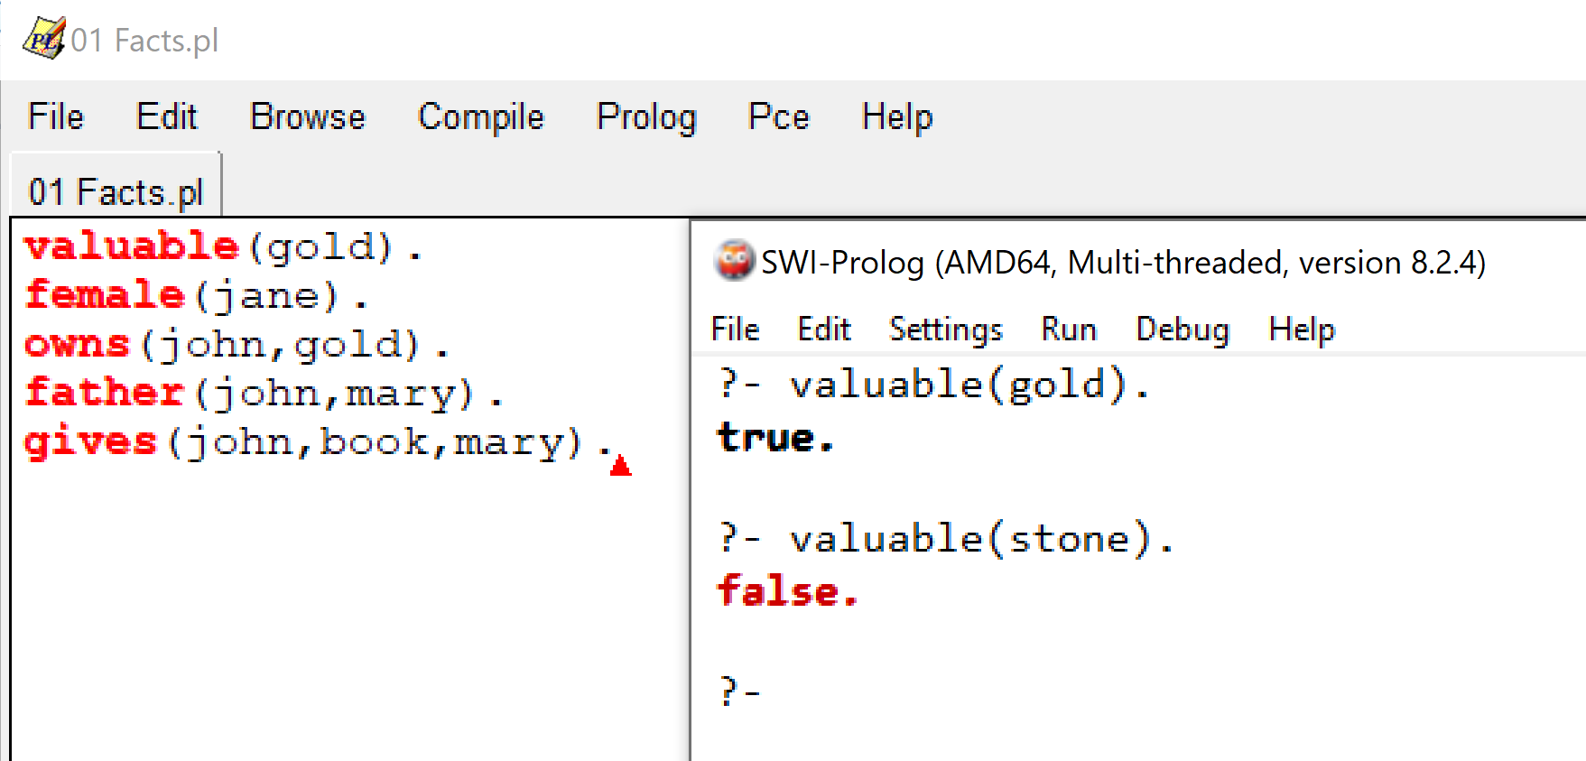
Prolog Example

Slide 37
Object-Oriented Programming
The procedural, functional and logic paradigms can all be extended with object-oriented features, though most OO languages have evolved from procedural languages.
Procedural and object-oriented programming
C++, Java, C#, Python, JavaScript
Functional and object-oriented programming
CLOS
Logic and object-oriented programming
Prolog++

Slide 39

Why Read Code? [5]
Read the code when you add new feature
Read the code when you need to fix a bug
Read the code when you want to improve it
Read the code when you want to learn how to write better code
Read the code as you do a code review
What’s your purpose?
What to read?

Slide 40
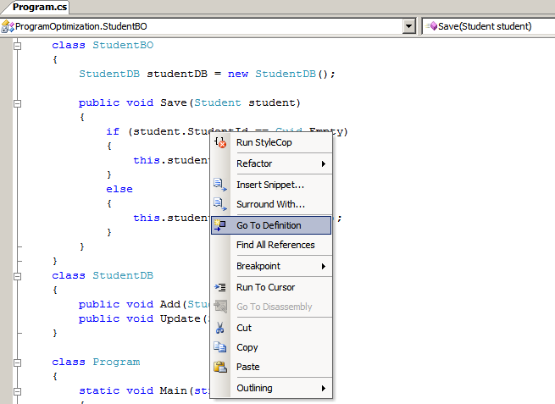
Use a Code Reading Tool
Is it a debugger? Is the code well formatted?
Collaborator
https://smartbear.com/product/collaborator/overview
Crucible
https://www.atlassian.com/software/crucible
Review board
http://www.reviewboard.org

Slide 41
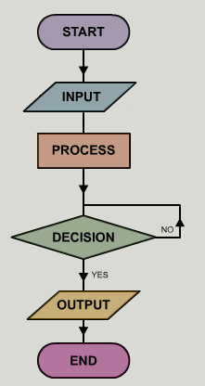
Identify Start and End Point
Where is the entry (main function)?
What are the input?
What are the outputs?

Slide 42



Trace the Code
What is the call? What does it do?
Where are we in the architecture?
Document everything that is difficult to understand.

Slide 44
Which Programming Language?
https://www.tiobe.com/tiobe-index/
The TIOBE Programming Community index is an indicator of the popularity of programming languages.
The index is updated once a month. The ratings are based on the number of skilled engineers world-wide, courses and third party vendors. Popular search engines such as Google, Bing, Yahoo!, Wikipedia, Amazon, YouTube and Baidu are used to calculate the ratings.
It is important to note that the TIOBE index is not about the best programming language or the language in which most lines of code have been written.
The index can be used to check whether your programming skills are still up to date or to make a strategic decision about what programming language should be adopted when starting to build a new software system.

Slide 45

Thank You & See You Again

